Slide 1

Chief’s Rounds
January 21, 2022
Talia N. Shoshany MD, PGY-2

Slide 2
Chief Complaint
76M presents with 3 months of progressive RUL swelling

Slide 3
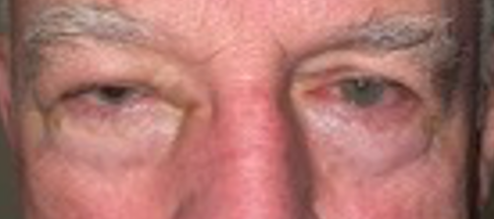
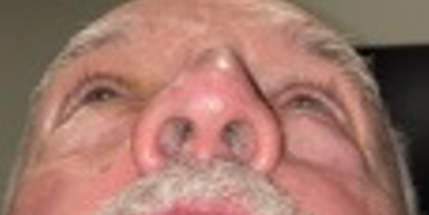
Notes:
Describe external photos
Periorbital edema, relative proptosis, 2mm mechanical ptosis

Slide 4
HPI
76M with 3 months of progressive RUL swelling
Positive ROS: burning pain, epiphora, mechanical superior visual field defect from his eyelid and intermittent double vision on downgaze
Negative ROS: no blurry vision, F/F, pain with EOM, HA, PT, oropharyngeal symptoms, fevers/chills
Previously diagnosed with allergies and possible sinusitis- treated with a course of antibiotics and Medrol dose pack without relief.
Notes:
Referred to oculoplastics

Slide 5
Past Medical History
Follicular lymphoma of R arm & bronchus (s/p radiation and rituximab, no e/o recurrence on recent PET)
Prostate cancer (in remission without metastatic disease)
Cutaneous SCC of L brow and forehead (s/p Mohs, no recurrence)
HTN
HLD
Past Ocular History
Myopia
No past ocular surgery
Medications
Levothyroxine
Atorvastatin
Social History
Social drinker
Never smoker
No IVDU, no marijuana
Family History
Non-contributory

Slide 6
Exam
<
20/25-1
<
Reactive, no APD
<
25
V
P
T
20/20
Reactive, no APD
20
cc
<
Full when lifting upper lid
<
8/8
CVF
Color
Full
8/8
<
-1 abduction, -1 infraduction
Motility
Full

Slide 7
Anterior Exam
OD |  | OS
1+ periorbital edema, non tender, no V1/V2 hypesthesia. + relative proptosis | External | WNL
2mm mechanical ptosis | Lids | Normal
1+ injection, inferior chemosis. No corkscrewing of vessels | Conjunctiva | White and Quiet
Clear | Cornea | Clear
Deep and Quiet | Anterior Chamber | Deep and Quiet
Flat | Iris | Flat
2+ NS | Lens | 2+ NS
Hertel- 105, 20, 15

Slide 8
DFE
OD |  | OS
+PVD, no vit cell | Vitreous | +PVD, no vit cell
Sharp margins, no pallor or heme C/D 0.2 | Disc | Sharp margins, no pallor or heme C/D 0.2
No edema or hemorrhage | Macula | No edema or hemorrhage
Normal | Vessels | Normal
No retinal lesions | Periphery | No retinal lesions

Slide 9
Further workup
Initial differential?
Further workup?
Labs?
Imaging?
Notes:
what is your initial differential and what further workup would you obtain

Slide 10
Further workup
Concern for an orbital process
Initial ddx:
Inflammatory
Neoplastic (i.e., recurrence of lymphoma)
Vascular (CC fistula)
Less likely infectious given symptom duration
Notes:
periorbital swelling, mechanical ptosis, relative proptosis, chemosis and elevated intraocular pressure were concerning for an orbital process

Slide 11
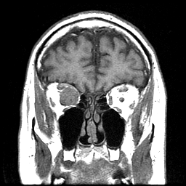
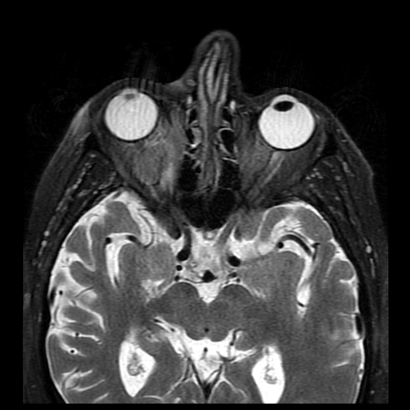
MRI
Notes:
MRI orbits was obtained with and without contrast – T1 and T2 weighted
Dr. Flanders – can you describe what you see?
-3.1x2.2x2.2 cm right intraconal mass with capsular enhancement, causing local mass effect on the globe and optic nerve
-The signal characteristics were low in signal on T1 (A) and T2 weighted images (B).

Slide 12
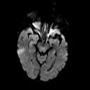
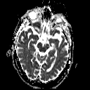
MRI
Notes:
DWI and ADC images demonstrating restricted diffusion

Slide 13
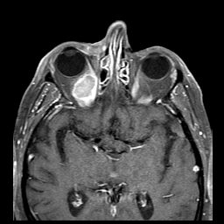
MRI
Notes:
Post contrast- there was homogeneous enhancement of the tumor matrix with a well-defined capsule that featured increased enhancement

Slide 14
Differential?
Notes:
Dr Flanders- what is your differential based on these imaging characteristics?

Slide 15
Differential
Notes:
Should we include a comprehensive differential here ?

Slide 16
Next steps?
Orbitotomy and diagnostic biopsy
Baseline testing: OCT ON/Macula WNL

Slide 17
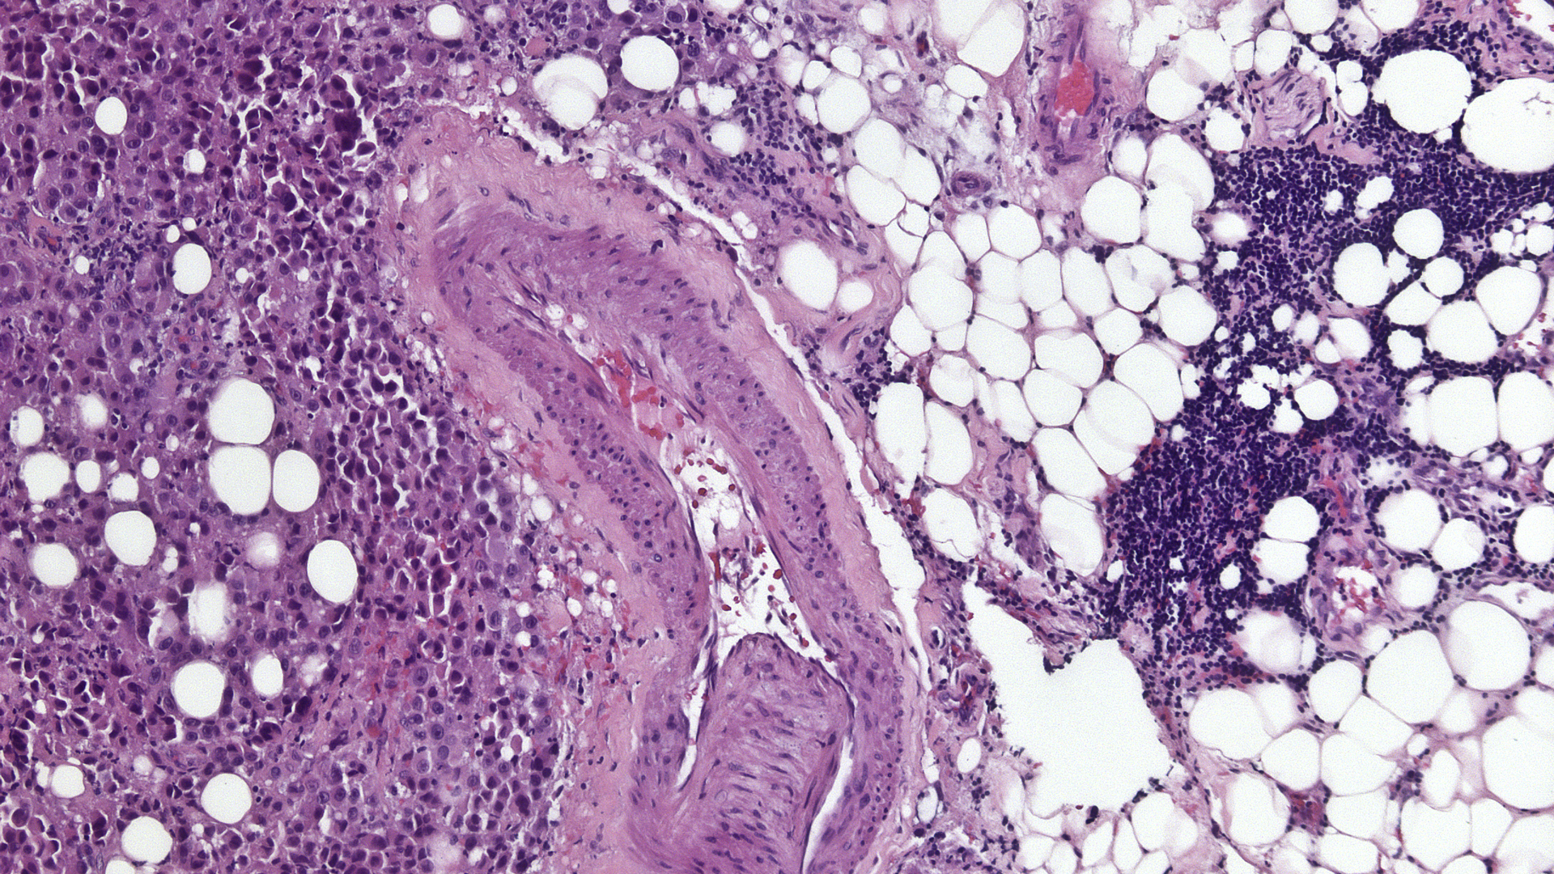
Tumor
Lymphocytic aggregate
Adipose tissue
Notes:
Dr. Milman -can you please describe the histopathologic findings
infiltrate of neoplastic, mitotically active epithelioid cells within the skeletal muscle arranged in sheets, strands, and nests

Slide 18
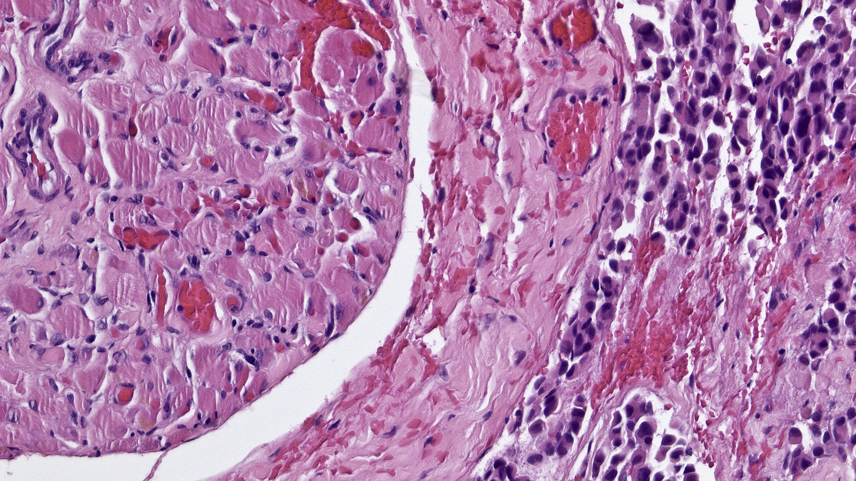
Tumor
Skeletal muscle

Slide 19
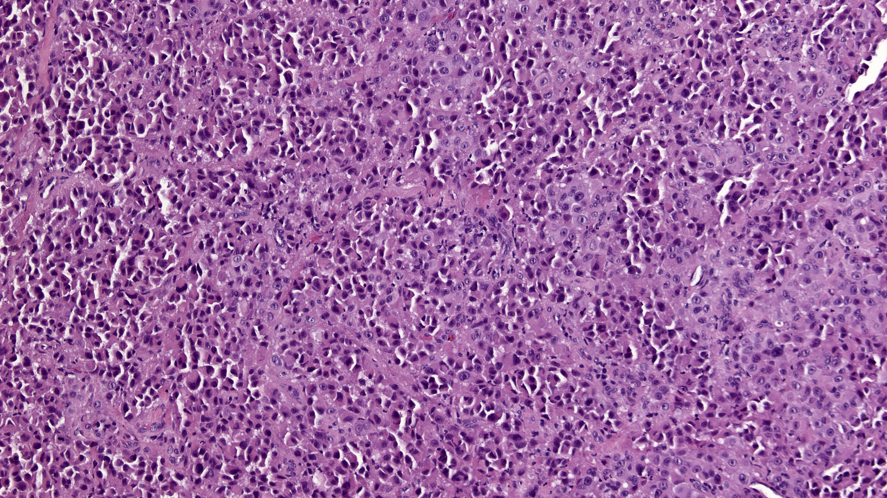

Slide 20
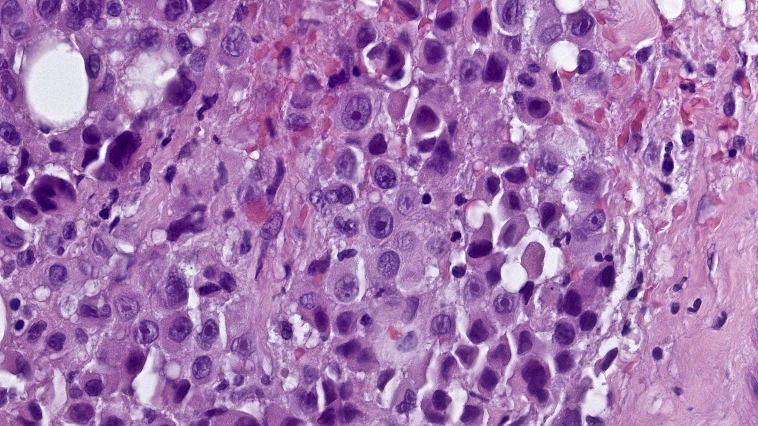

Slide 21
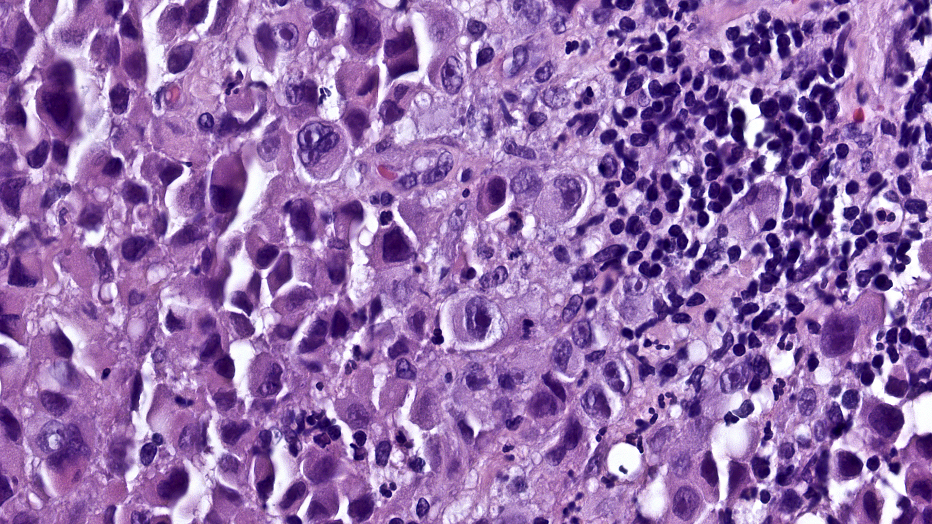
Lymphocytic aggregate

Slide 22
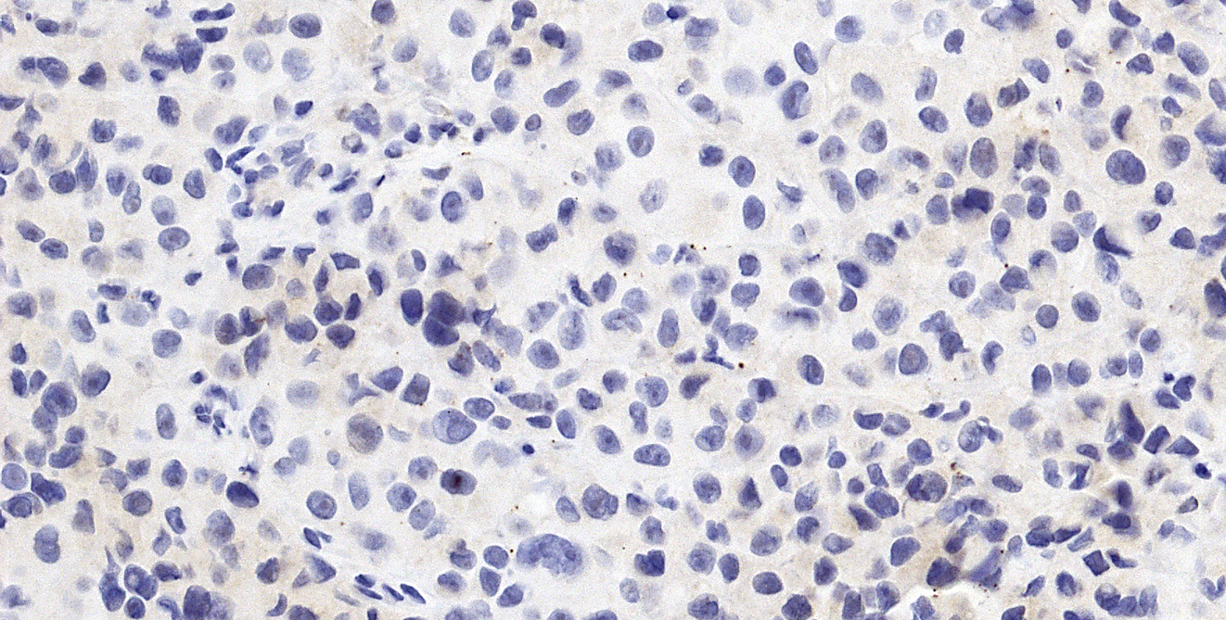
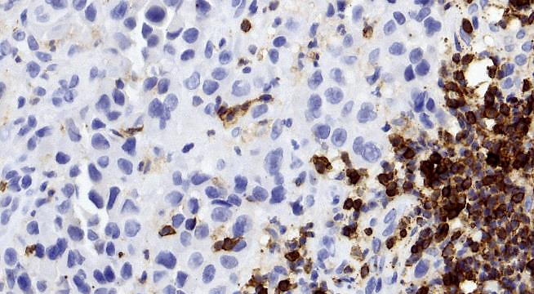
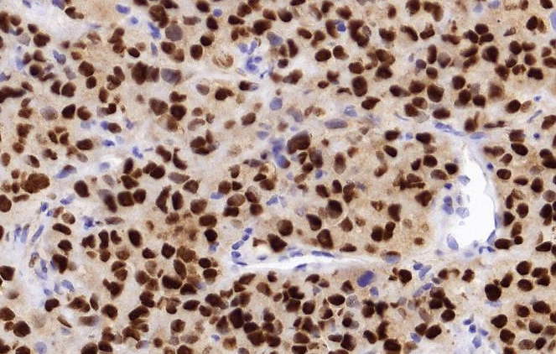
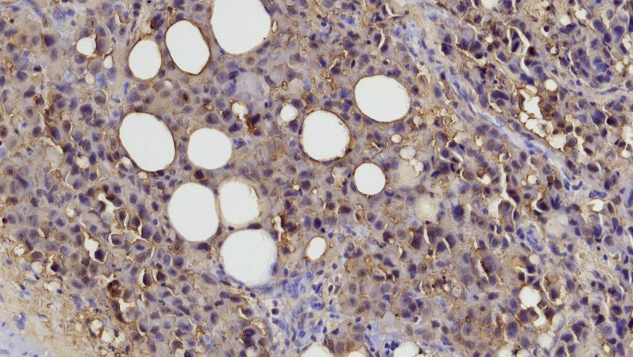
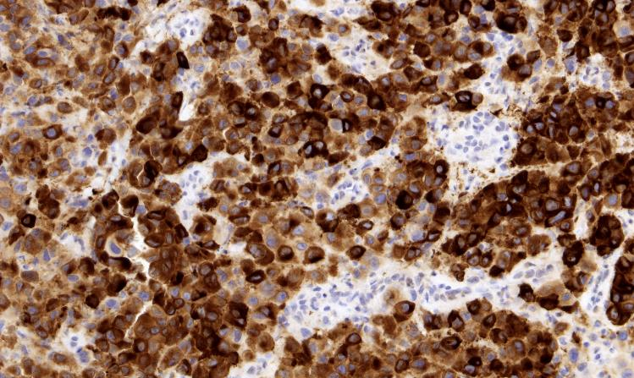
Cytokeratins, NKX3.1
CD45
SOX10
S100
Melan-A

Slide 23
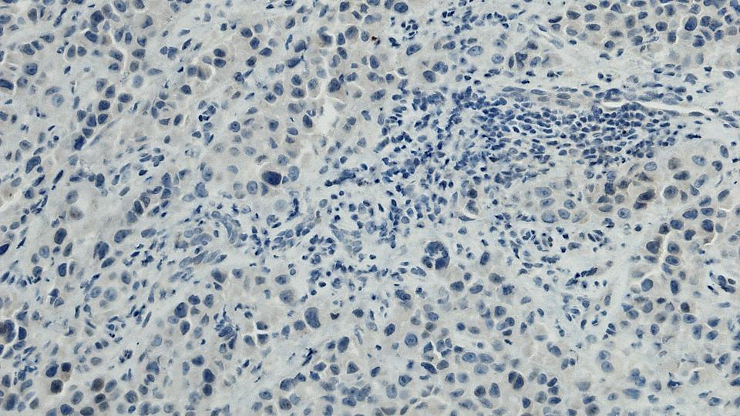
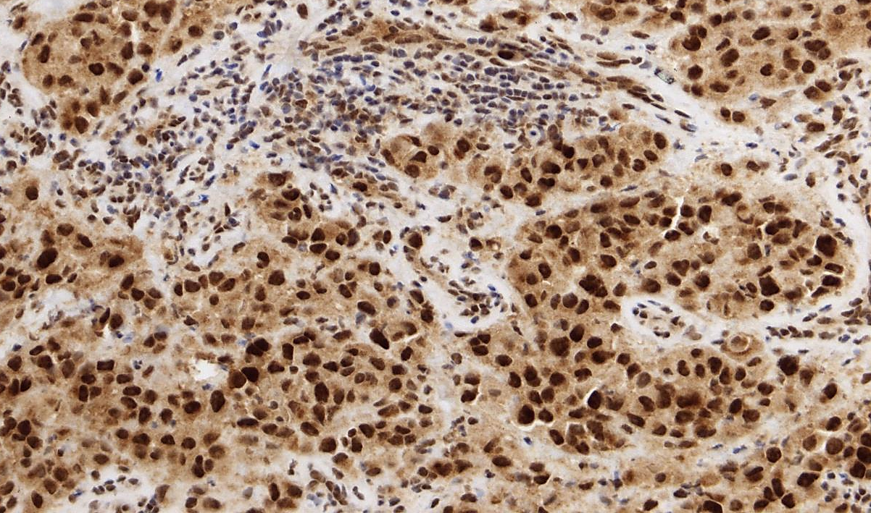
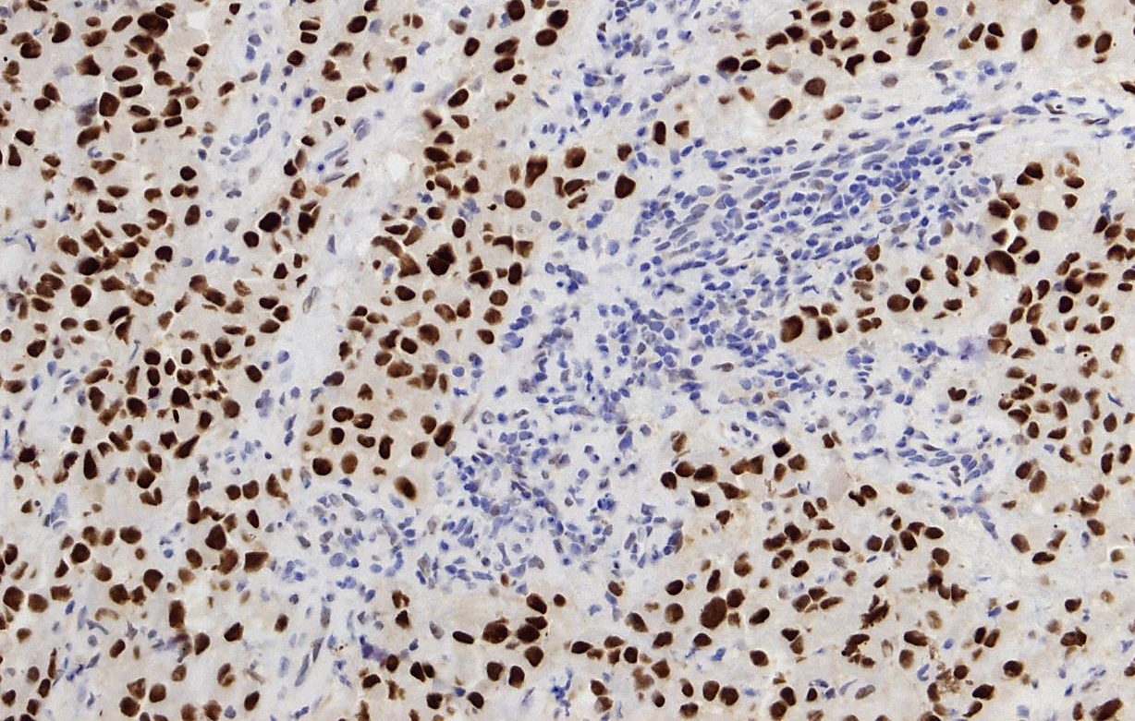
Additional immunohistochemical studies
BRAF
BAP1
PRAME
Notes:
Dr. Milman - What was your diagnosis based on pathology slides?

Slide 24
Further workup
Thought to be metastatic melanoma given involvement of the muscle
Sent to medical oncology for systemic workup
CT chest/abdomen/pelvis – negative
MRI brain – no metastatic lesions
Skin exam – no cutaneous lesions concerning for malignancy
Repeat Ophthalmic exam – no signs of a primary conjunctival, uveal, or cutaneous melanocytic lesion, including oculodermal melanocytosis (nevus of Ota).
Notes:
Dr. Orloff – can you describe your initial thoughts on this case and what further workup was pursued:

Slide 25
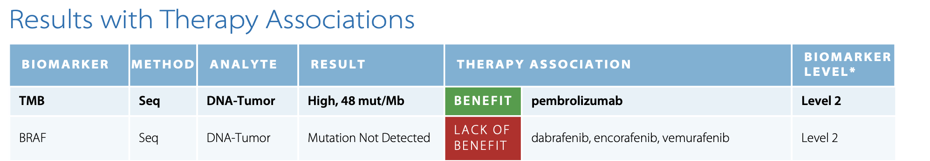
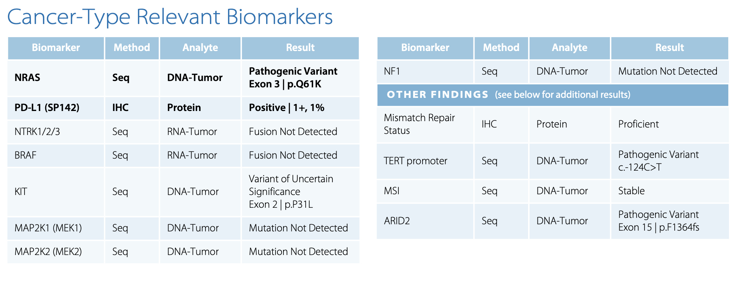
Genetic Profiling
Notes:
High mutational burden
NRAS, TERT mutations
PDL1 positivity
No evidence of GNAQ, GNA11, SF3B1, and BAP1 mutations
Dr. Orloff- do you do genetic profiling for every melanoma?
What do you make of this genetic analysis
compatible with a cutaneous-like or conjunctival melanoma-like mutational signature. Yet, comprehensive examination and imaging studies did not identify a primary site or other foci of metastatic disease. Thus, although an occurrence of primary orbital melanoma involving the EOM without pre-existing nevoid component is highly concerning for metastasis, POM emerged as a diagnosis of exclusion.

Slide 26



POM accounts for <1% of all primary orbital malignancies, with fewer than 90 cases reported in the literature to date
They arise from melanocytes of the leptomeninges or ciliary nerves or from ectopic nests of orbital melanocytes andares often associated with the nevus of Ota (90%), orbital melanocytosis (50%), or cellular blue nevus
Presenting symptoms: unilateral proptosis (73%), decreased visual acuity (32%), periorbital pain (14%), diplopia (15%), and palpable mass (9%)
On MRI, they may exhibit the unique characteristic of T1W hyperintensity and T2W hypointensity, attributed to melanin’s paramagnetic properties.
Notes:
POM = melanomas in the orbit that are not arising from the uvea, conjunctiva, or metastatic site

Slide 27
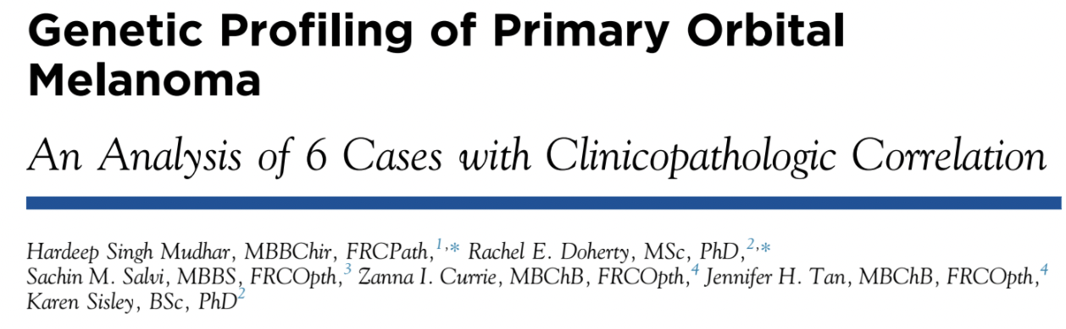
Cutaneous and conjunctival melanomas harbor UV-signature mutations and exhibit a high mutational burden.
MAPK, KIT, TERT, PDL-1, BRAF and/or NRAS mutations
Uveal melanoma has a lower mutational burden
GNAQ, GNA11, EIF1AX, SF3B1, and BAP1 mutations
A study by Mudhar et al describes the genetic profiles of 6 cases of POM and divides them into two subgroups: uveal-melanoma-like group and conjunctival-melanoma-like group
Postulated that the proximity of the tumor to the conjunctiva and thus UV damage dictates the genetic mutations
Notes:
Genetic profiling of melanomas has been helpful in determining tumor origin and targeted therapy.
UV mutations/ High TMB from sun damage
Little is known about genetic profiling of POM
Newer data is demonstrating that there is more overlap between cutaneous, mucosal, conjunctival and uveal melanomas, making it difficult to establish the origin conclusively from genetic profiling alone.^{7,12-14}

Slide 28
Treatment Options
Excision vs exenteration
+/- radiation
Adjuvant vs neoadjuvant immunotherapy with PDL1 inhibitors
Notes:
Dr Orloff, can you walk us through your discussion with the patient regarding treatment options and prognosis?

Slide 29
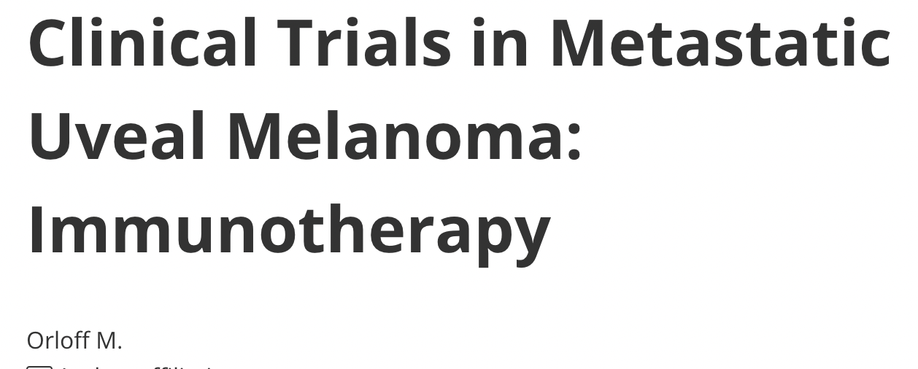
Although CTLA-4 and PD-1 inhibitors are widely used in cutaneous melanoma, they have shown less promise in ocular melanomas.
Believed that the small mutation burden in uveal melanoma causes decreased recognition by immune cells and explains this lack of benefit to checkpoint inhibitors
However, given the high mutational burden in our patient, it as thought to be beneficial
Experience with checkpoint inhibitors in POM has yet to be published

Slide 30
Surgery
Exenteration with free flap (combined oculoplastics, ENT procedure)
no evidence of cranial base invasion and negative margins were obtained at the orbital apex intra-operatively
No post op radiation

Slide 31
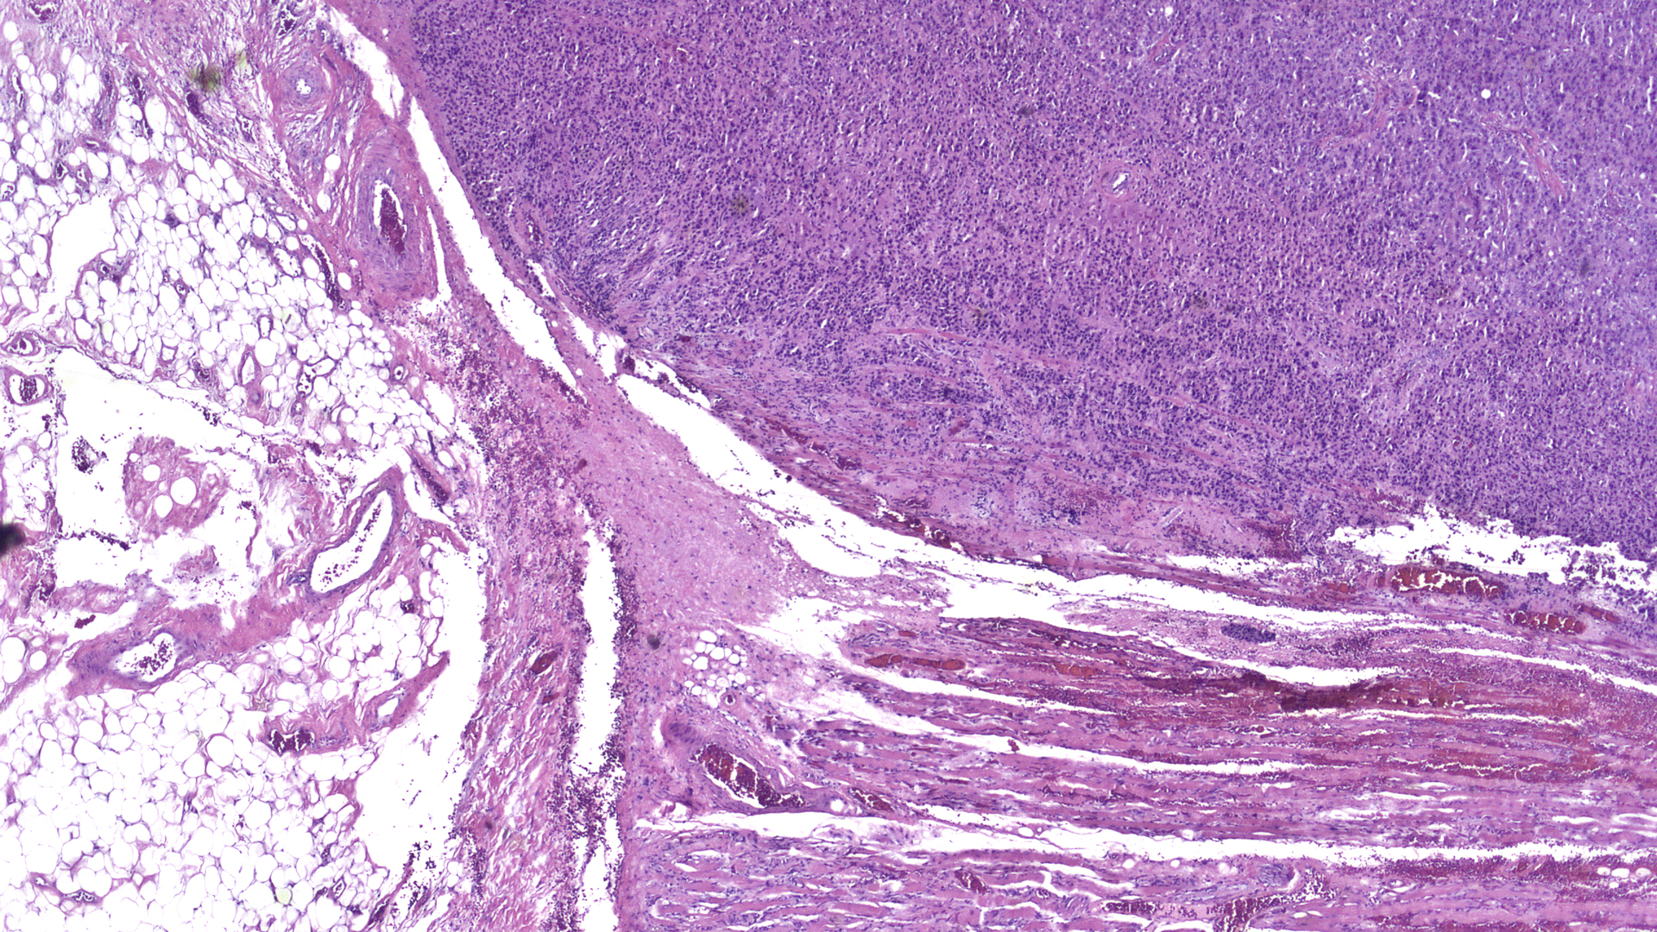
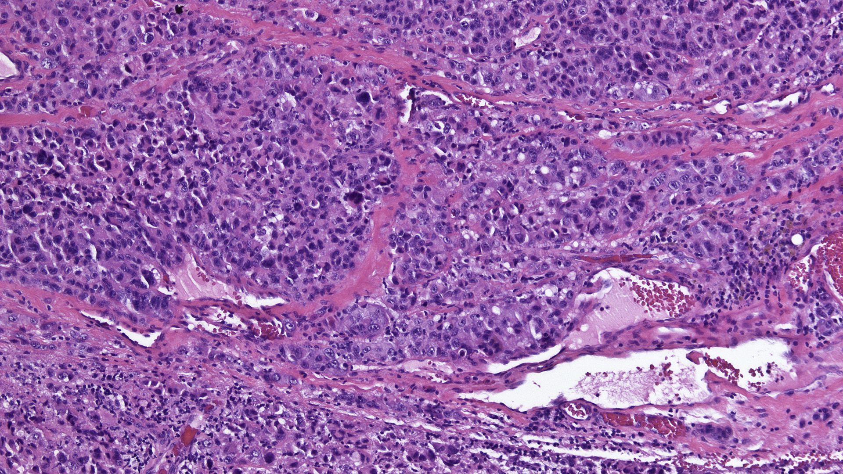
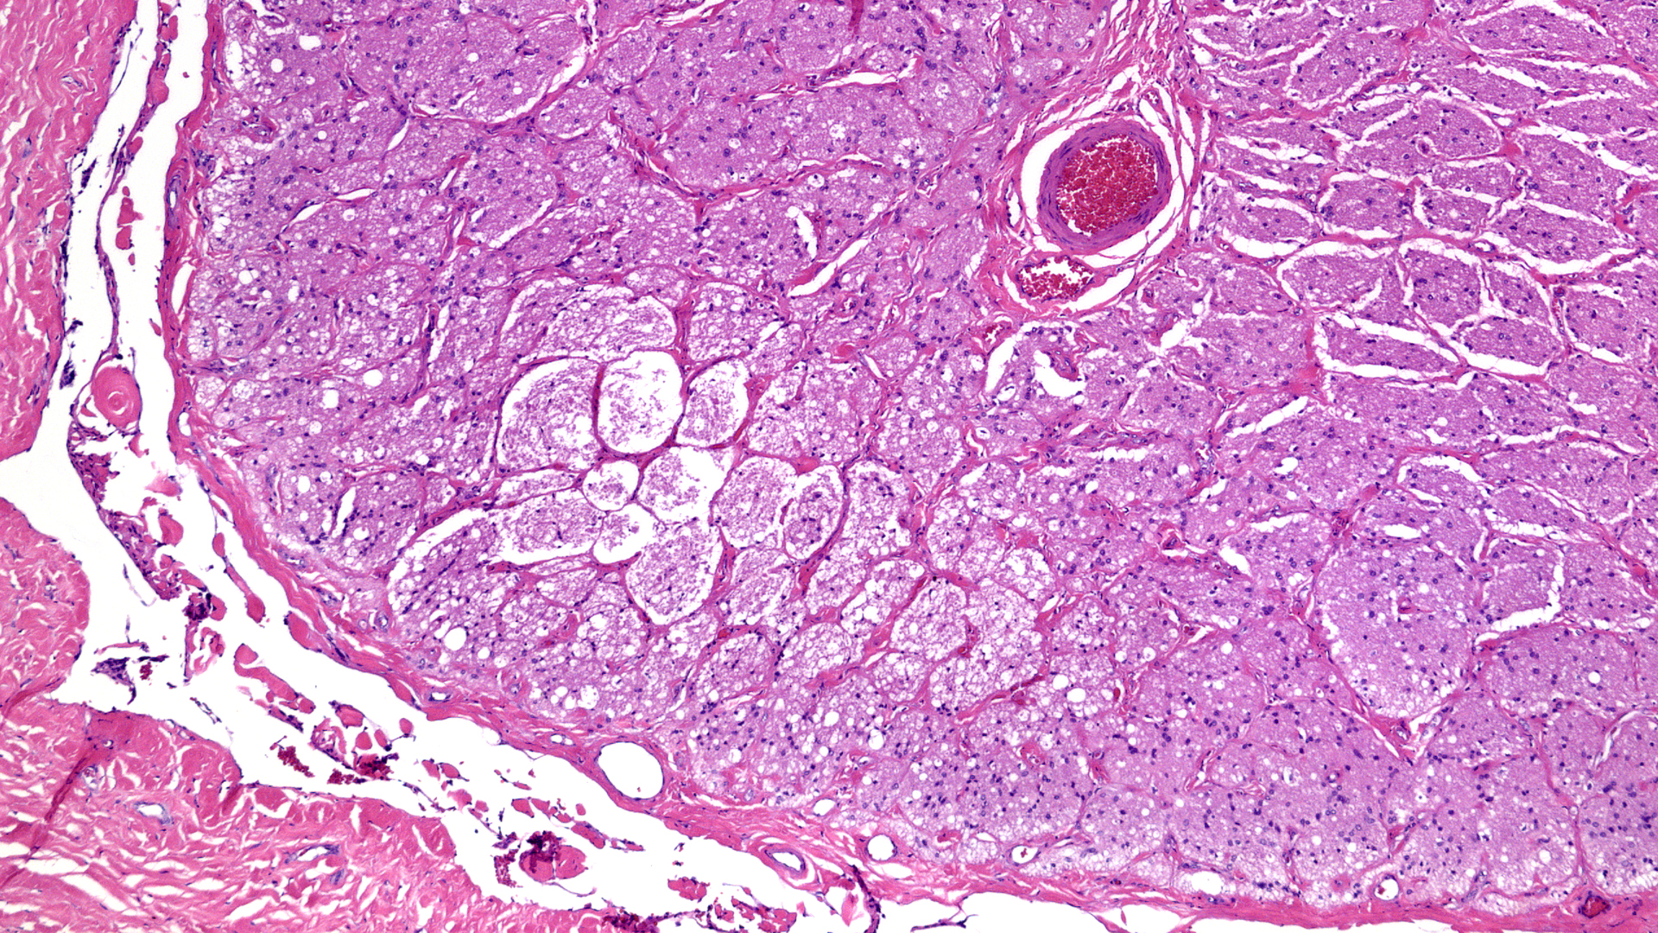
Final pathology
Orbital melanoma
No precursor lesion identified
No definitive lymphovascular space invasion identified
Globe not available for evaluation

Slide 32
Post-op course
Presumed primary orbital melanoma
Currently receiving adjuvant nivolumab monthly and surveillance PET scan every 3 months
On most recent PET scan he maintains no evidence of metastatic disease.

Slide 33
Summary
Case of primary orbital melanoma presenting as unilateral lid edema and proptosis
Rare entity, but diagnosis of exclusion given no origin found or systemic disease
Genetic profiling can prove helpful for diagnosis, prognosis, and treatment modalities
Promising role of immunotherapy in POM

Slide 34
References
Shields CL, Shields JA. Ocular melanoma: relatively rare but requiring respect. Clin Dermatol. 2009 Jan-Feb;27(1):122-33. doi: 10.1016/j.clindermatol.2008.09.010. PMID: 19095158.
Modupe O. Adetunji , Brendan McGeehan , Vivian Lee , Maureen G. Maguire & César A. Briceño (2020): Primary orbital melanoma: A report of a case and comprehensive review of the literature, Orbit, DOI: 10.1080/01676830.2020.1818265
Tellada M, Specht CS, McLean IW, Grossniklaus HE, Zimmerman LE. Primary orbital melanomas. Ophthalmology. 1996;103(6):929–932. doi:10.1016/S0161- 6420(96)30585-X.
Mudhar HS, Doherty RE, Salvi SM, Currie ZI, Tan JH, Sisley K. Genetic profiling of primary orbital melanoma: an analysis of 6 cases with clinicopathologic correlation. Ophthalmology. 2019;126(7):1045–1052. doi:10.1016/j. ophtha.2018.12.047.
Uduma, UF, Titalom, K. Intra-orbital Malignant Melanoma: Role of Mr Imaging (a Case Report and Literature Review). Glob J Health Sci. 2012 Jan; 4(1):253-258
Schank TE, Hassel JC. Immunotherapies for the treatment of uveal melanoma—history and future. Cancers (Basel). 2019;11(8). doi:10.3390/ cancers11081048.
Orloff, M. “Clinical Trials in Metastatic Uveal Melanoma: Immunotherapy.: Ocul. Oncol. Pathol. 2020.

Slide 35
Thank you!
Dr. Alison Watson
Dr. Tatyana Milman
Dr. Marlana Orloff
Dr. Madalina Tuluc
Dr. Adam Flanders

Slide 36
Tumor
Adipose tissue
Extraocular muscle
Notes:
Possible extra slides if time permits
Slides from exenteration

Slide 38
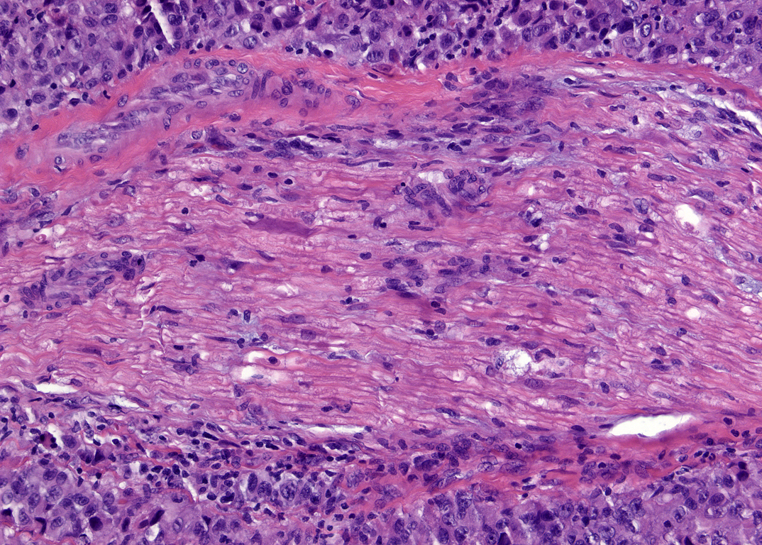
Peripheral nerve

Slide 39
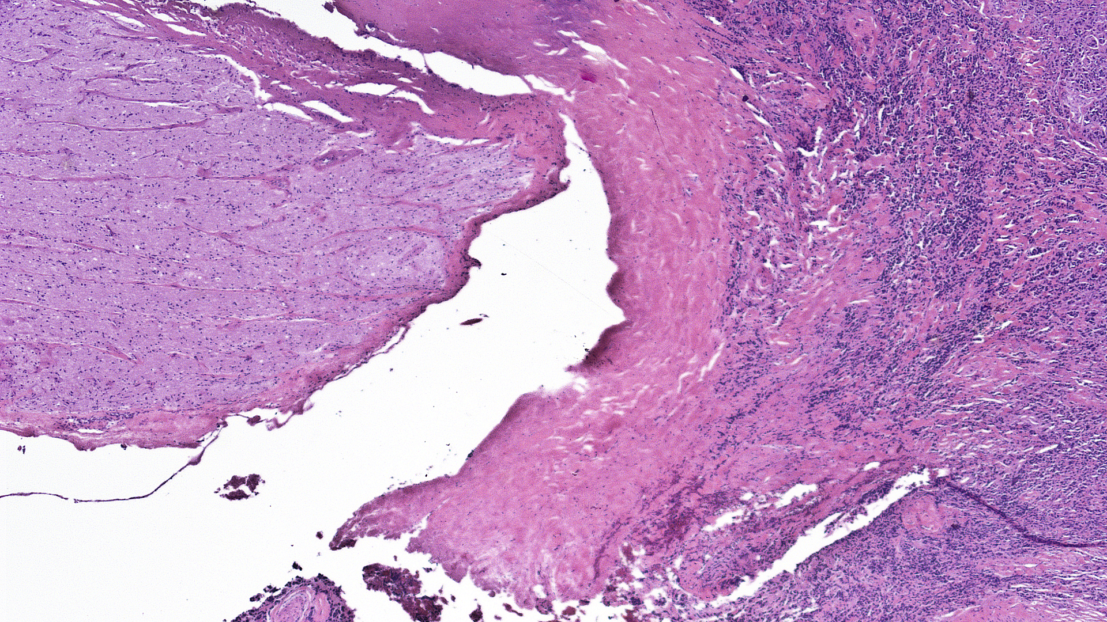
Optic nerve
Dura
Tumor

Slide 40
Segmental optic atrophy

Slide 41
Repeat exam OD
August 2021
20/100
3+ APD
Central scotoma
Motility - -3 abduction, -3 supraduction, -3 infrafuction
Lids – complete ptosis
Conjunctiva – No melanocytosis
DFE – no e/o nevus or suspicious mass
May 2021
20/25 -1
Pupils reactive, no APD
CVF – full
Motility - -1 abduction, -1 infraduction
Lids – 2mm mechanical ptosis
Notes:
Pt unfortunately took time to get all testing – by the time he came back 3 months later, his exam and symptoms had progressed

